Slide 1
CAR RENTAL SYSTEM

Slide 2
Problem Statement
People often face problems when renting cars, such as not knowing which cars are available, having to book manually, or dealing with confusing pricing.
Car rental companies also struggle to keep track of bookings, returns, and payments.
Can we generate extra income form our cars with safety.

Slide 3
Why we chose this topic?
A car rental system is needed to make the process easier, faster, and more organized for both customers and the hosts.
Car renting Service is a Growing Market.
It is a Real-World Application.
Problem Solving Opportunities.
Data Driven insights.

Slide 4
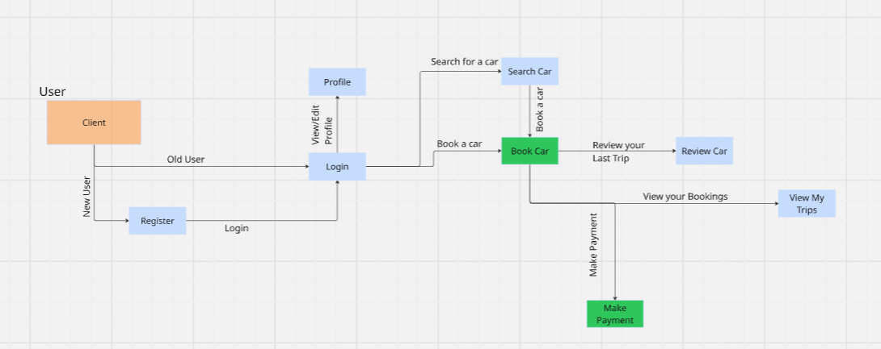
User Flow Diagram

Slide 5
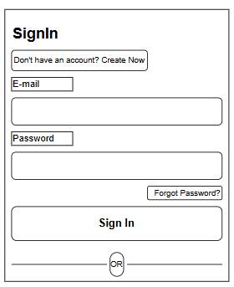
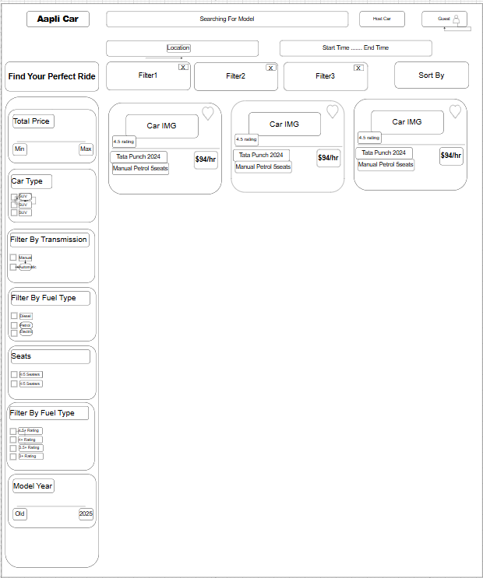
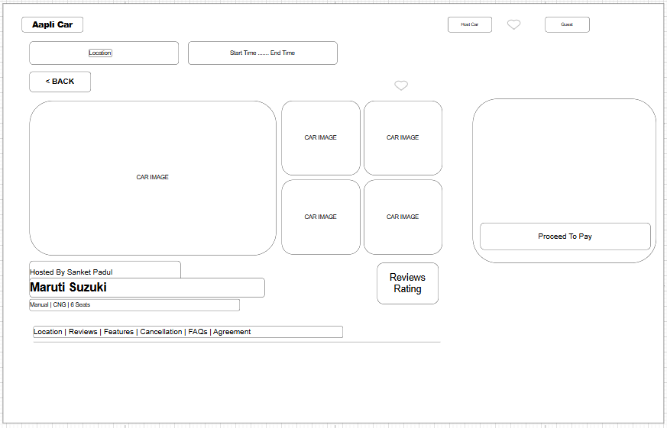
User UI
Sign in
Search Car
Book Car

Slide 6
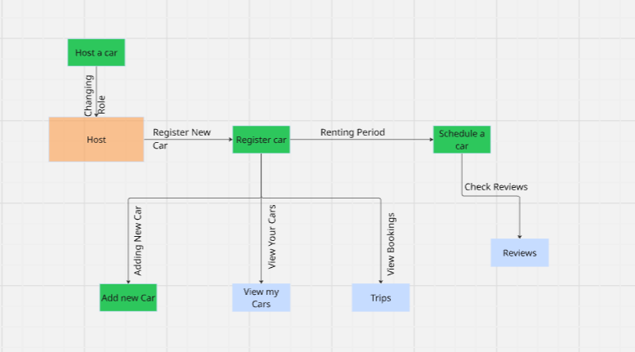
Host Flow Diagram

Slide 7
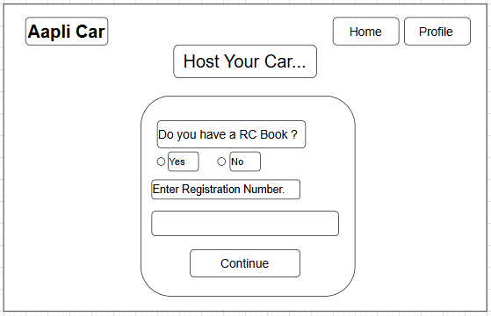
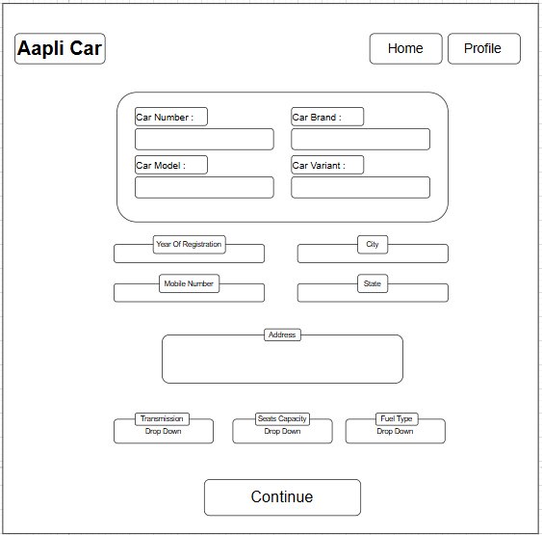
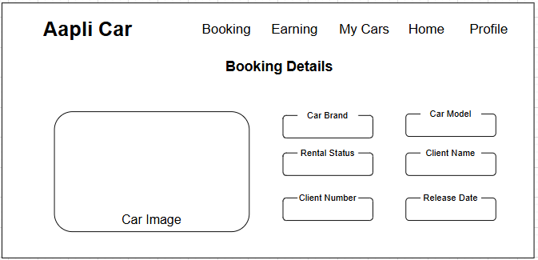
Host UI
Enter RC Details
Check Car Details
Booking Details

Slide 8
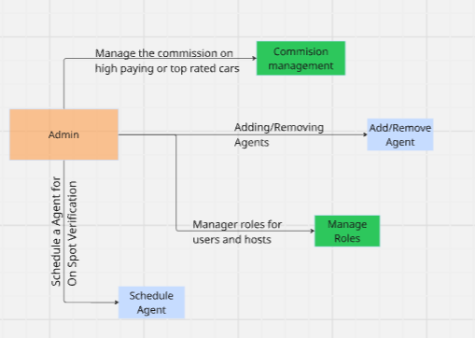
Admin Flow Diagram

Slide 9
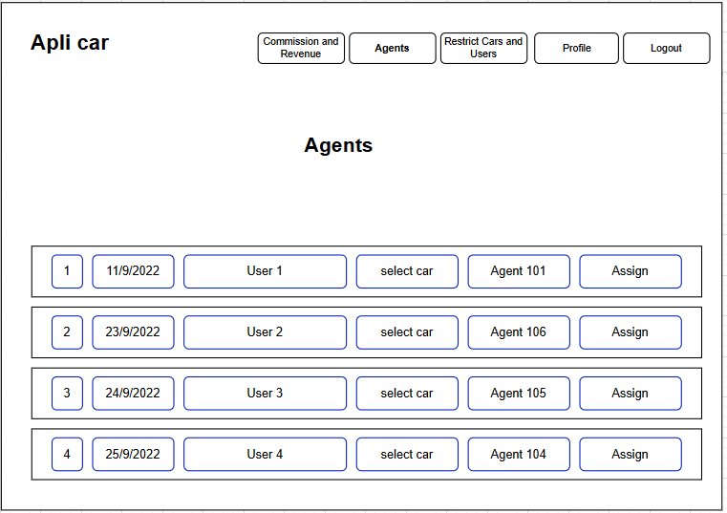
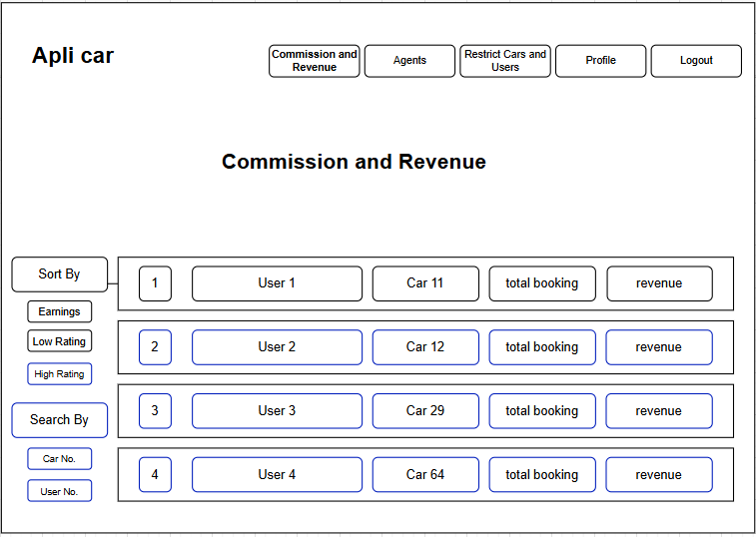
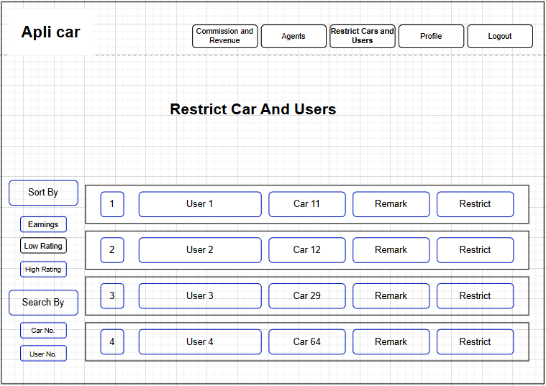
Admin UI
Schedule Agent
Commission And Revenue
Restrict User

Slide 10
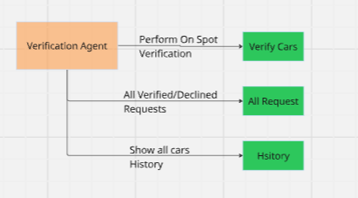
Verification Agent Flow Diagram

Slide 11
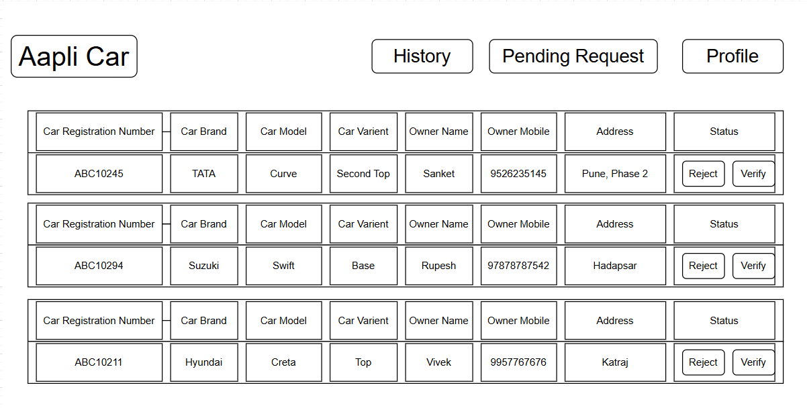
Agent UI

Slide 12
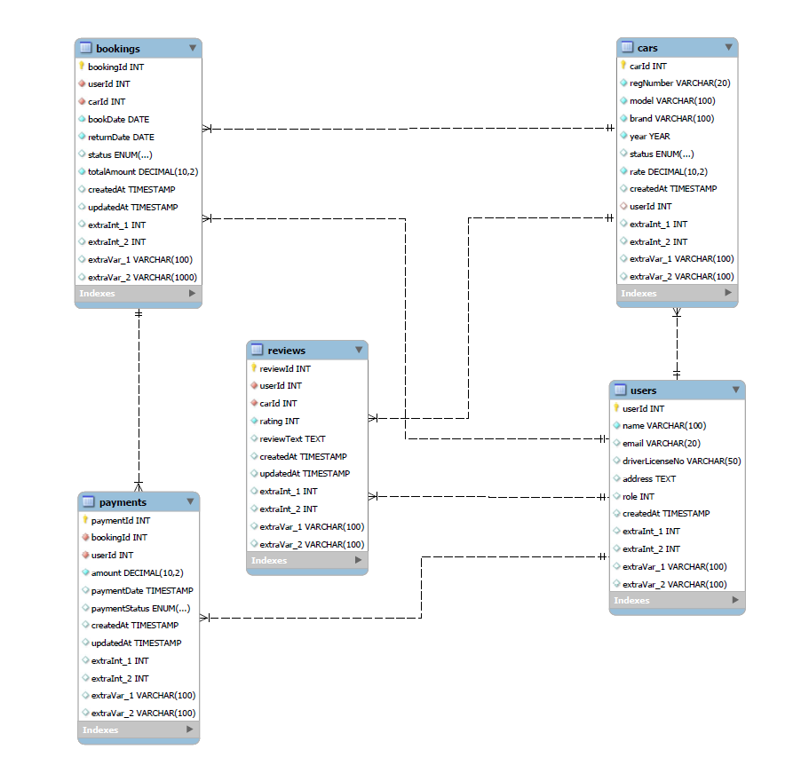
ER Diagram

